Slide 1
Elmir Guliyev
Neptune: HVABRZ
Course name: Stream Mining
3rd Project - DWM

Slide 2
Concept drift
Concept drift means that the statistical properties of the target variable, which the model is trying to predict, change over time in unforeseen ways. This causes problems because the predictions become less accurate as time passes

Slide 3

What is a DWM Algorithm?
Dynamic weighted majority (DWM) maintains an ensemble of base learners, predicts using a weighted-majority vote of these "experts", and dynamically creates and deletes experts in response to changes in performance.

Slide 4
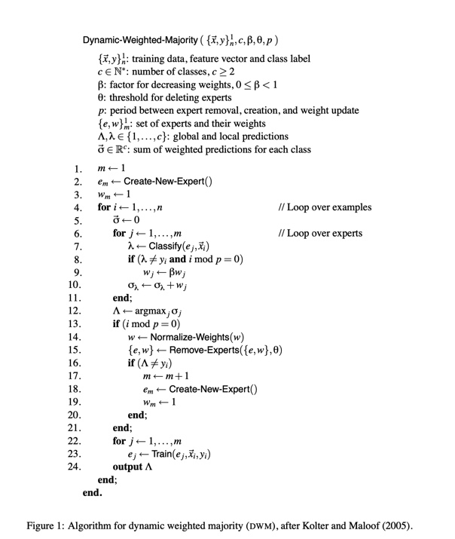
Algorithm
Dynamic-Weighted-Majority

Slide 5
Most usual experiments
Stagger
SEA

Slide 6
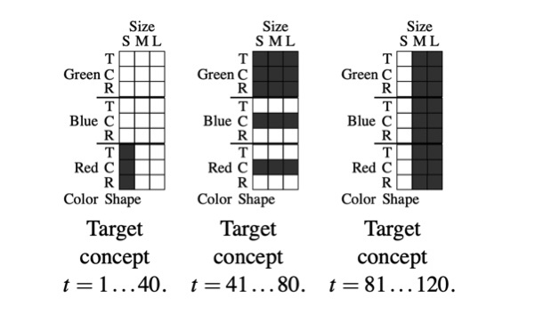
Stagger concept

Slide 7
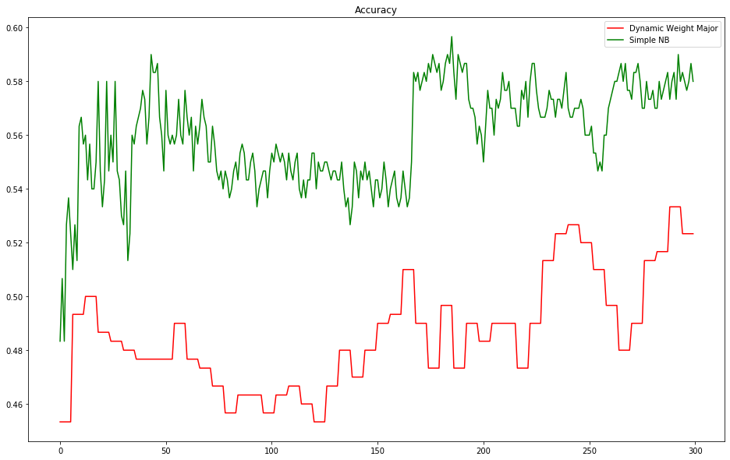
Stagger approach vs NB

Slide 8
Specific data[Elmir]
Generating new data every runtime
Identifying sleeping experts based on the consideration of the weights, days

Slide 9
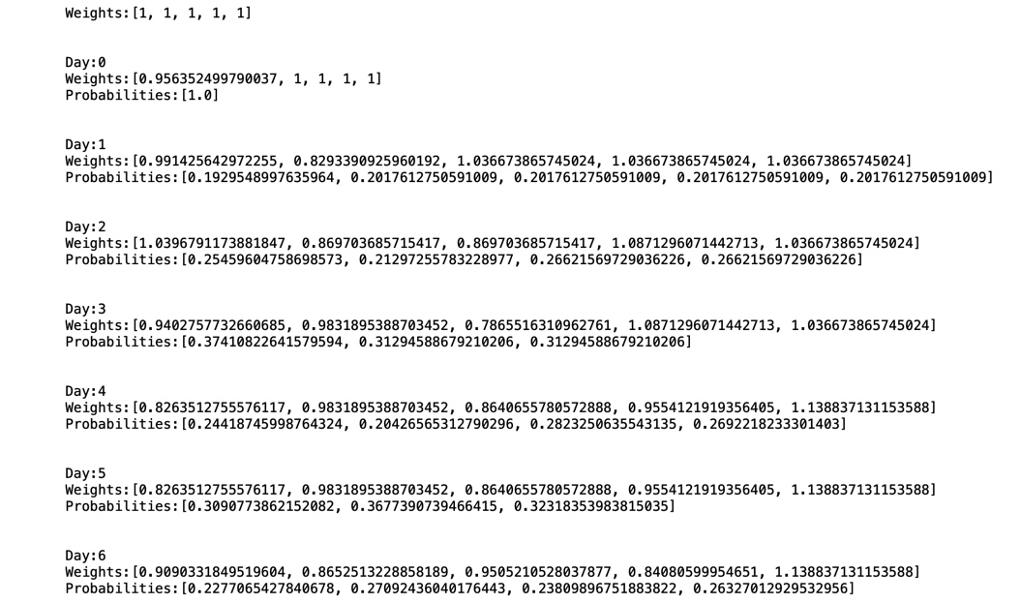
Sleeping experts

Slide 10
Main reason behind
To be able to catch real time updates and inputs
To be able to point out overdue ones.

Slide 11
Used materials
DWM Research paper given by the professor
Google
Github
Kaggle

Slide 12
Thank you for your attention.

